Slide 1

POKEMON BATTLE PREDICTION A MACHINE LEARNING MODEL TO PREDICT BATTLE OUTCOMES

Slide 2
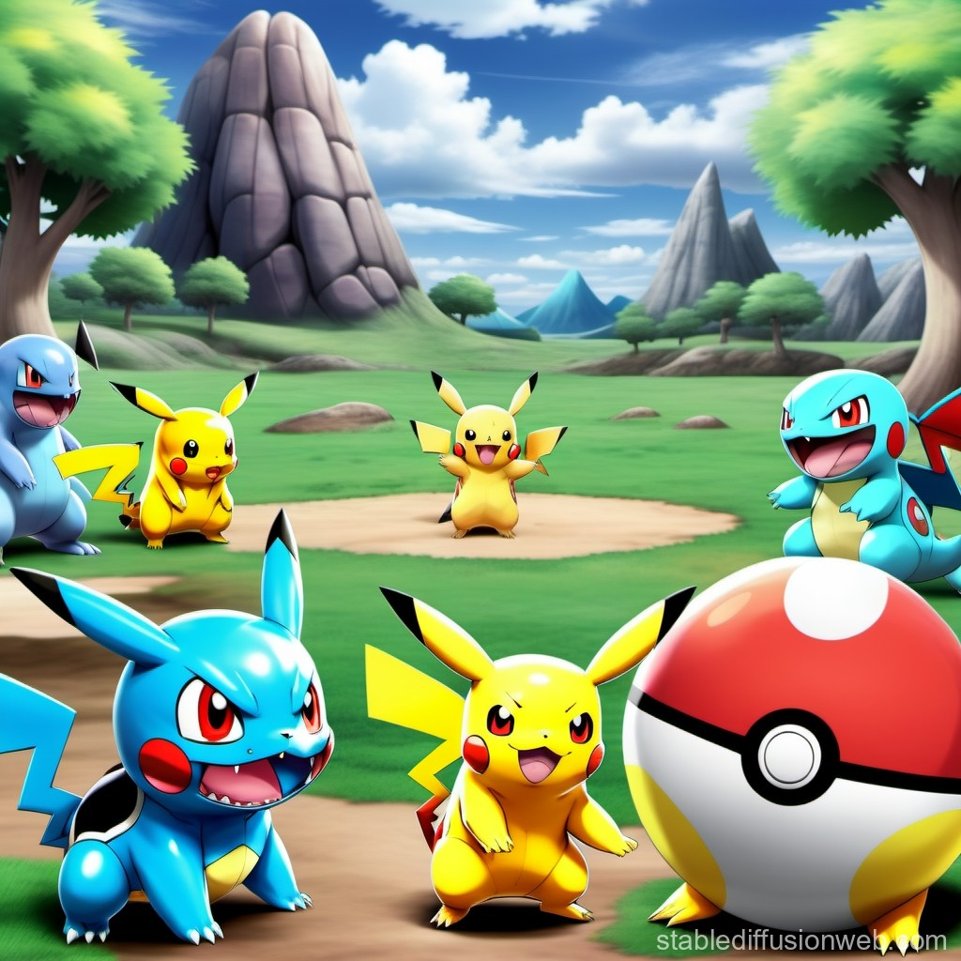

INTRODUCTION
The aim of this project is to develop a Machine Learning model that can accurately predict the outcome of Pokemon battles based on various Pokemon attributes.

Slide 3
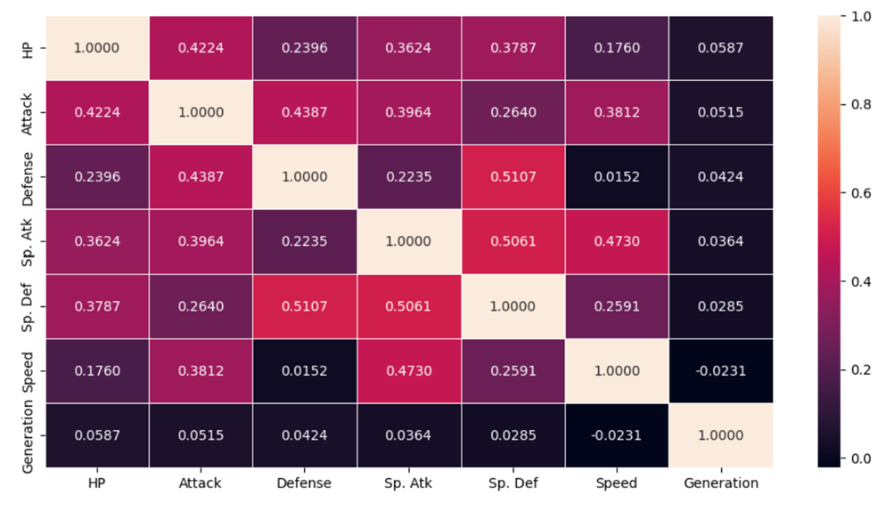
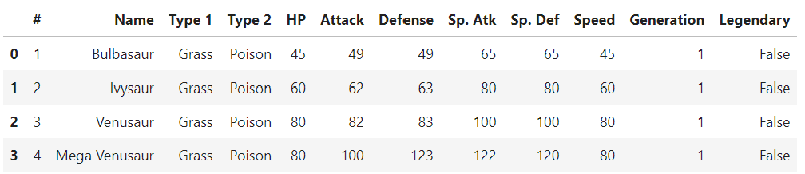
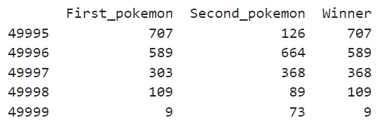
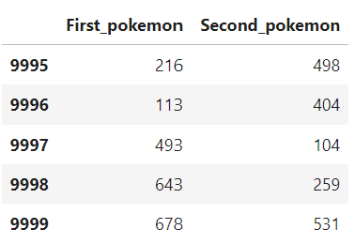
DATA EXPLORATION
The dataset contains 3 files.
Pokemon dataset(attributes):
Combats dataset:
Tests dataset:

Slide 4
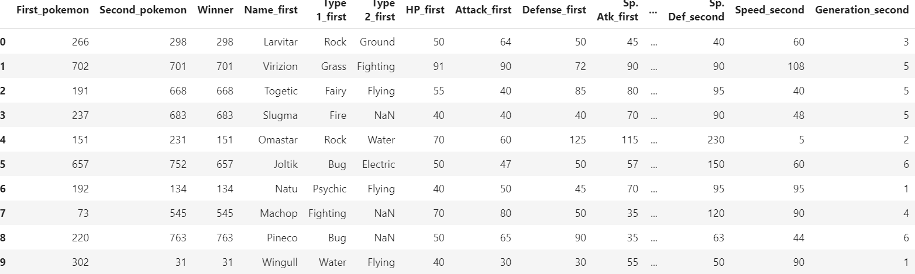
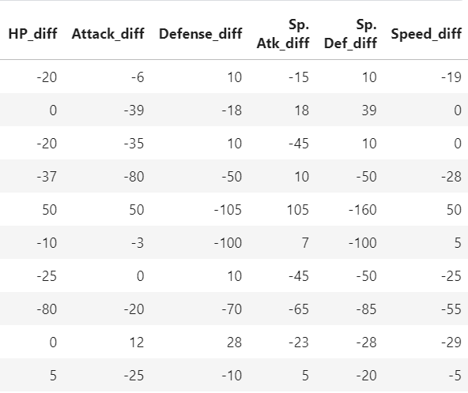
DATA PREPROCESSING
Data Merging: Merged the combat data with the Pokémon data for both the first and second Pokémon in the battle. This allowed me to create new features based on their attribute differences.
Feature Engineering: Calculated the difference between the first and second Pokémon’s stats. This helps the model learn which Pokémon has an advantage based on these attributes.

Slide 5
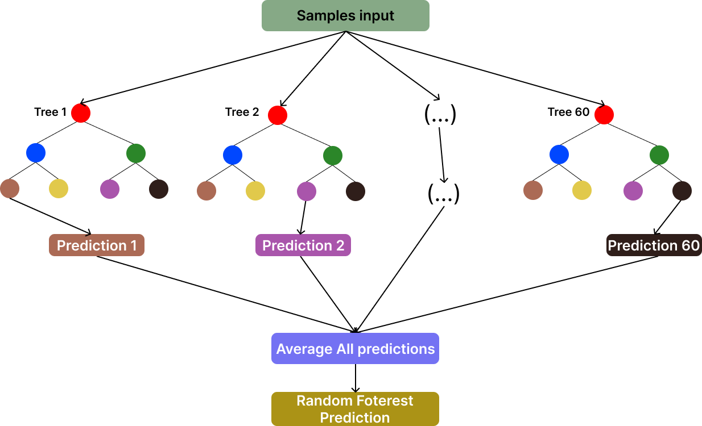
MODEL SELECTION
Why Random Forest?
I chose Random Forest because it is an ensemble learning method, which combines multiple decision trees to create a more robust and accurate model.
Random Forest utilizes the bagging (Bootstrap Aggregating) technique, where each tree is trained on a random subset of the data. This helps in reducing variance and improving the model's generalization to unseen data.
Another advantage of Random Forest is its ability to automatically provide feature importance scores, which can help in understanding which Pokémon attributes are most influential in predicting battle outcomes.

Slide 6
Why not other models?
Why not Logistic regression to predict battle out comes? It is a simpler model that could provide interpretable results, but it might not capture complex relationships in the data as effectively as the Random Forest model.
Why not XGBoost? Another powerful ensemble method known for its performance in structured data, but I opted for Random Forest due to its simplicity and faster training time in this context.

Slide 7
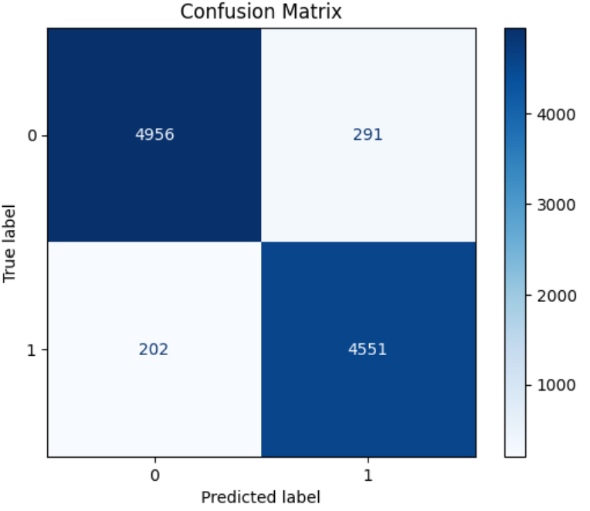
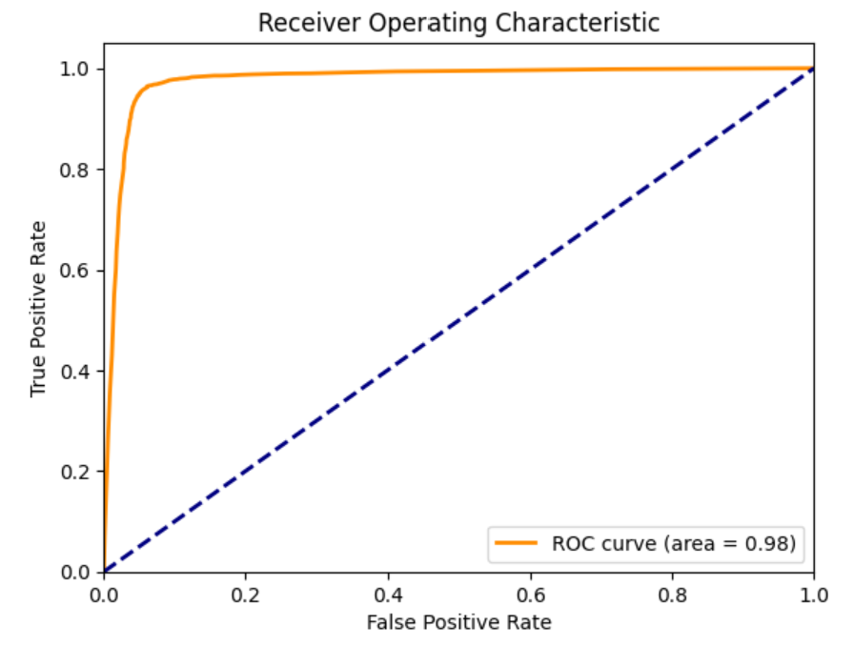
MODEL TRAINING AND EVALUATION
TRAINING PROCESS:
Data Splitting: I split the data into training (80%) and testing (20%) sets to evaluate the model's performance.
Standardization: I scaled the features using StandardScaler to ensure the model treats all features equally.
MODEL EVALUATION: I evaluated the model using accuracy, precision, recall, F1 score, and ROC AUC score.
• Accuracy: 95.00%
• Precision: 94.10%
• Recall: 95.45%
• F1 Score: 94.78%
• ROC AUC Score: 95.02%

Slide 8
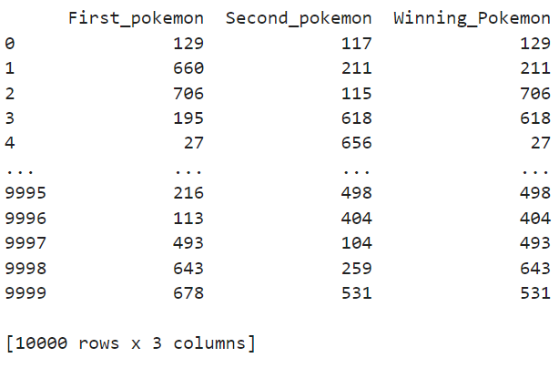
PREDICTIONS
Test data preparation: Similar to the training data, I merged the test data with the Pokemon. I scaled the test data using the same scaler as the training data. data and calculated the attribute differences.
Mapping Predictions: I mapped the prediction results back to the Pokemon IDs to determine the actual winning Pokémon.

Slide 9
CHALLENGES AND LIMITATIONS
Combining the combat data with the Pokémon attributes required careful data cleaning and merging. Ensuring that all relevant information was correctly aligned and that no critical data was lost was a crucial but challenging step.
The model’s predictions are heavily dependent on the selected features. If the dataset does not include or accurately represent certain attributes (like abilities or hidden abilities), the model might not fully capture the complexity of Pokémon battles.
The dataset used may not cover all possible Pokémon or battle scenarios, limiting the generalizability of the model to other contexts or newer Pokémon. For example, the model might struggle with Pokémon or battle scenarios not represented in the training data.

Slide 10
FUTURE WORK
Future work could involve trying other machine learning models, such as XGBoost or Support Vector Machines (SVM), to see if they offer better performance or different insights. Comparing these models with Random Forest could lead to a more optimized solution.
Incorporating additional battle data, especially from newer Pokémon games or different formats (e.g., double battles), could help the model generalize better. More diverse data could also reduce the impact of class imbalance.

Slide 11

CONCLUSION
Random Forest Classifier
Accuracy
The feature importance analysis provides valuable insights that can inform future Pokemon strategies and enhance the understanding of battle dynamics.

